Slide 1
Lecture 16 Simulation Based Inference for Astrophysics and Cosmology
Lecturer: Dr Harry Bevins (htjb2)

Slide 2
Overview
What is Simulation Based Inference?
Approximate Bayesian Computation
Neural Posterior Estimation
Neural Ratio Estimation

Slide 3
What is Simulation Based Inference?

Slide 4
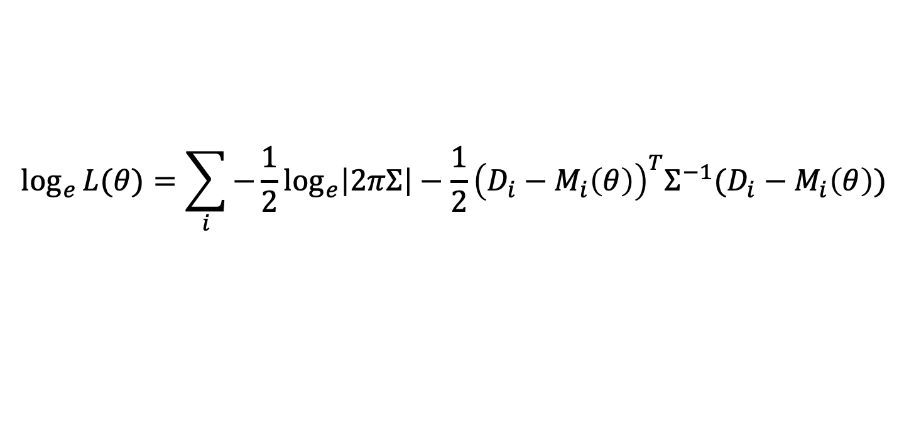
Why not emulate the likelihood?
$$\log_{e}{L(θ)}=\sum_{i}{−\frac{1}{2}\log_{e}\left|2πΣ\right|−\frac{1}{2}{\left(D_{i}−M_{i}\left(θ\right)\right)}^{T}Σ^{−1}(D_{i}−M_{i}\left(θ\right))}$$
In the last lecture I discussed how the likelihood defines the noise distribution we expect in our data
But often this is hard to know and approximations like the above Gaussian don’t really describe our data well
We looked at emulating the model describing our data but we can also think about emulating our likelihood function

Slide 5
Simulation Based Inference (SBI)
Sometimes referred to as Likelihood-free Inference (not a good name)
Or Implicit likelihood inference (a better name)
The idea is to learn an approximation for the likelihood or indeed the posterior via simulations of the data
Simulations here includes the physics we are interested in, and contaminating signals, the noise and the impact of the instrument we are observing with

Slide 6
Simulation Based Inference (SBI)
A number of different Simulation-Based inference algorithms
The idea has been around for a long time but has become more feasible with the advent of advance machine learning tools
Examples include; Approximate Bayesian Computation, Neural Posterior, Neural Likelihood, Neural Joint and Neural Ratio estimation
See K. Cranmer et a. [1911.01429] for a review

Slide 7
Simulation Based Inference (SBI)
Beneficial when
we can not analytically write the likelihood
we do not know the noise distribution in our data
the analytic likelihood is too computationally expensive

Slide 8
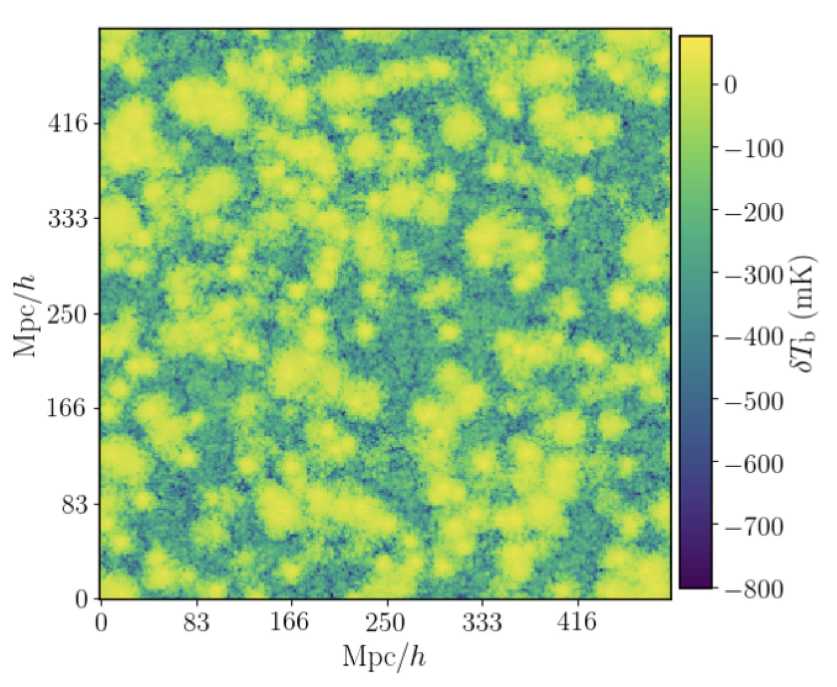
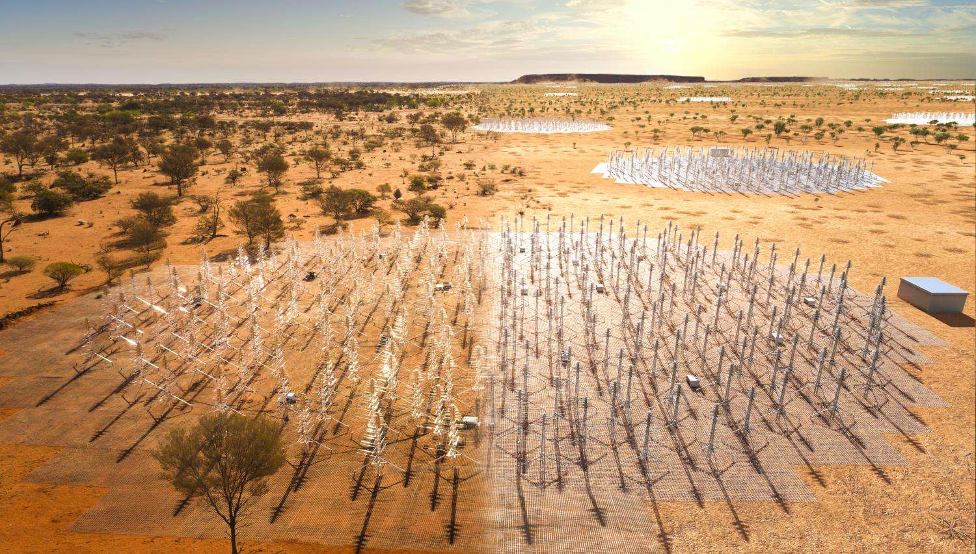
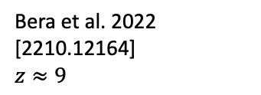
Field Level Inference
What cosmological parameters give us this 21-cm intensity map?
Could compress to summary statistics but there is potential loss of information
Hard to write an analytic likelihood
Turn to SBI instead
Bera et al. 2022 [2210.12164]
$$z≈9$$

Slide 9
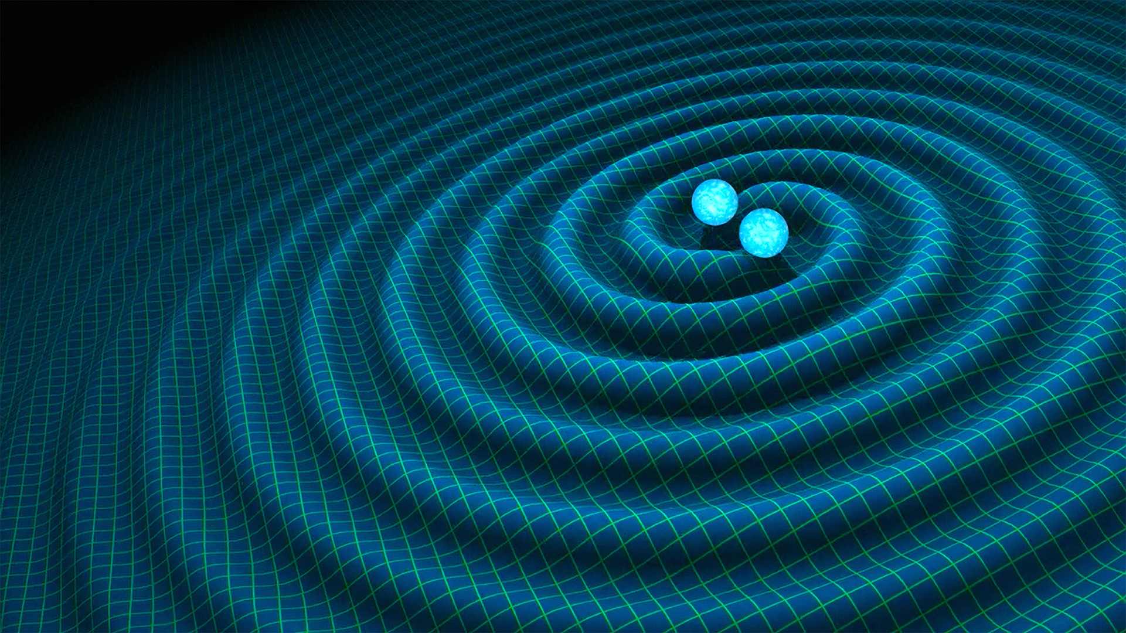
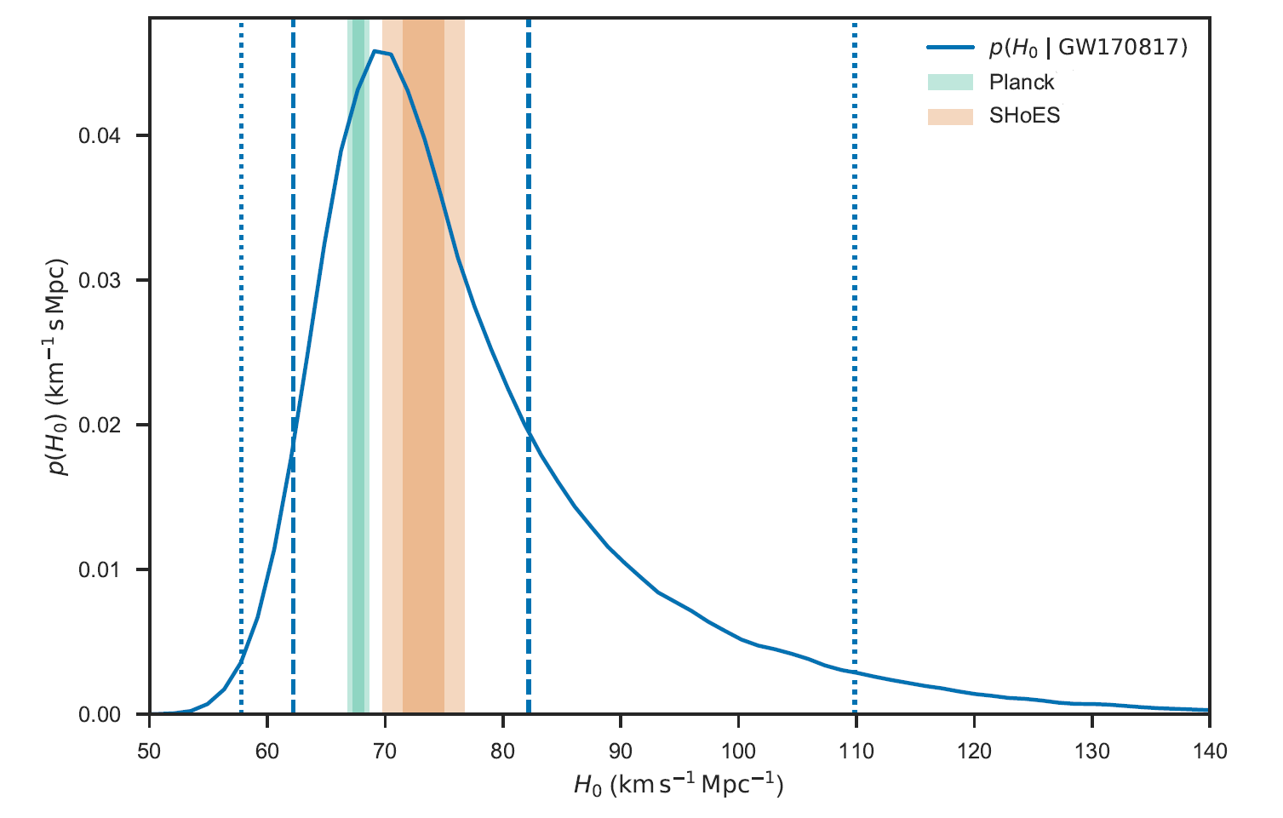
GW Follow Ups
GW chirps give us distance
Electromagnetic follow up observations of GWs can help us pinpoint the redshift of the sources
With distance and redshift we can learn about the expansion rate of the universe
But GWs emitted from cataclysmic events with short lifetimes so follow ups have to be triggered quickly
SBI allows us to do that
[1710.05835]

Slide 10
Approximate Bayesian Computation

Slide 11
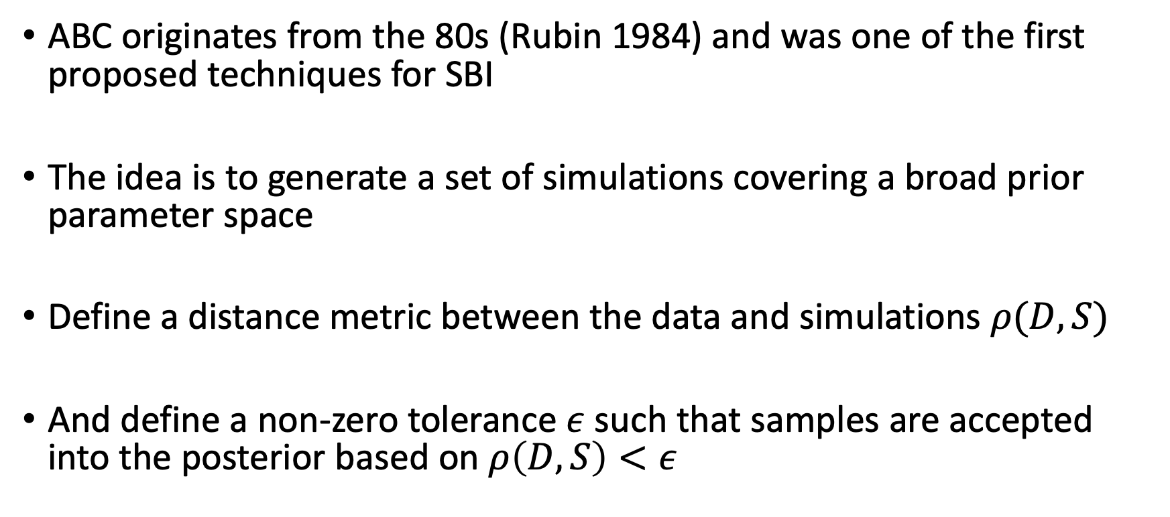
The idea
ABC originates from the 80s (Rubin 1984) and was one of the first proposed techniques for SBI
The idea is to generate a set of simulations covering a broad prior parameter space
Define a distance metric between the data and simulations $ρ(D, S)$
And define a non-zero tolerance $ε$ such that samples are accepted into the posterior based on $ρ\left(D, S\right)<ε$

Slide 12
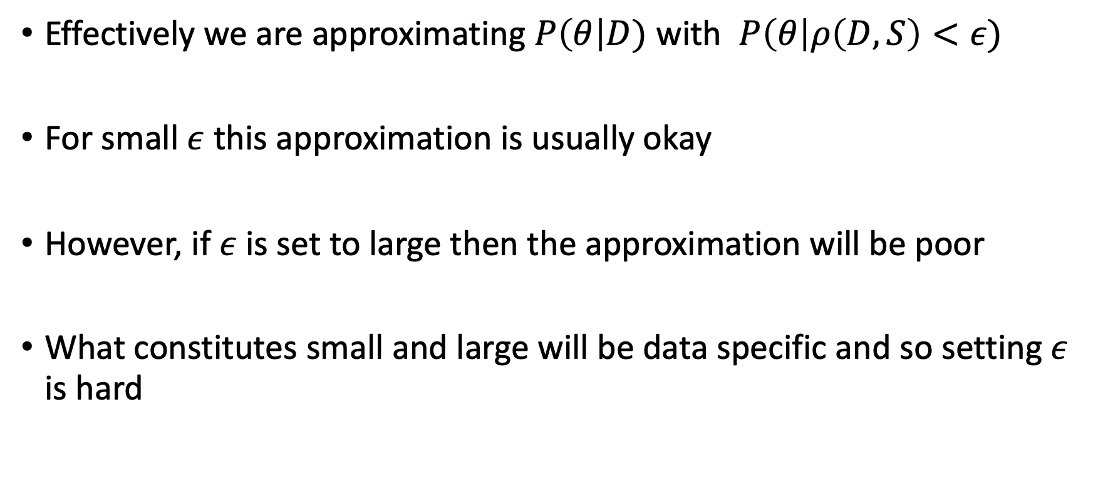
Approximating the posterior
Effectively we are approximating $P\left(θ\right|D)$ with $P\left(θ\right|ρ\left(D, S\right)<ε)$
For small $ε$ this approximation is usually okay
However, if $ε$ is set to large then the approximation will be poor
What constitutes small and large will be data specific and so setting $ε$ is hard

Slide 13
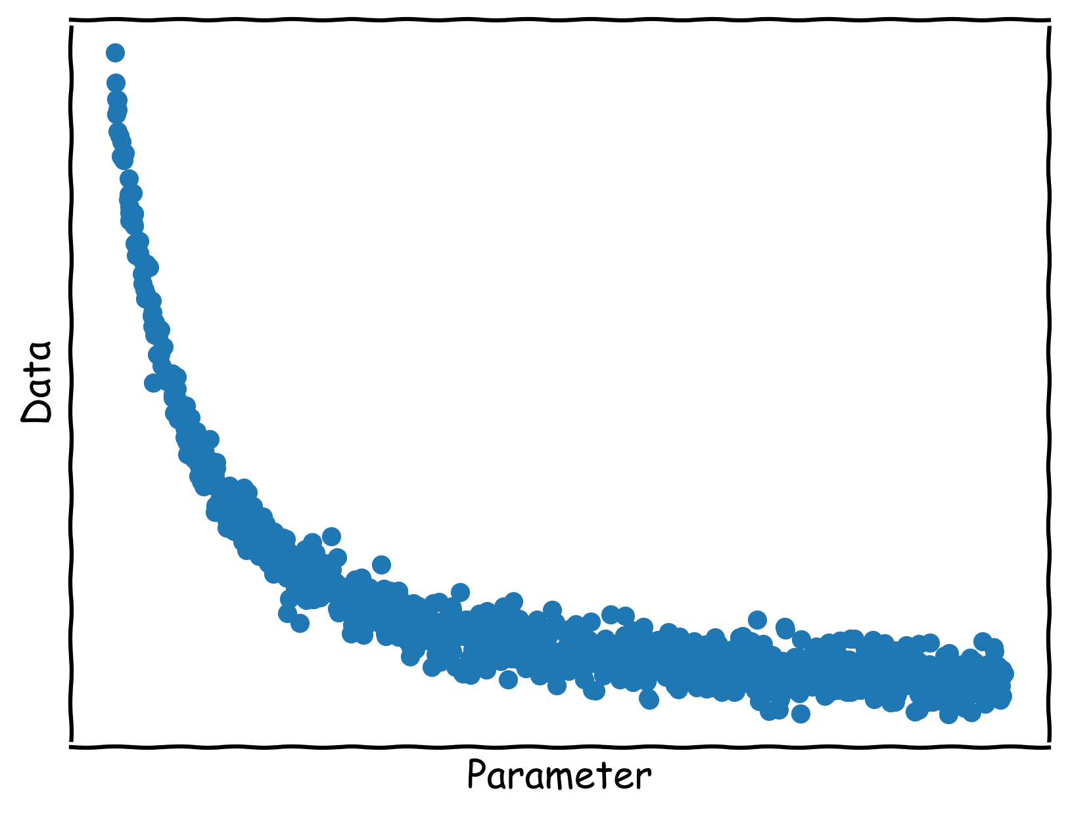
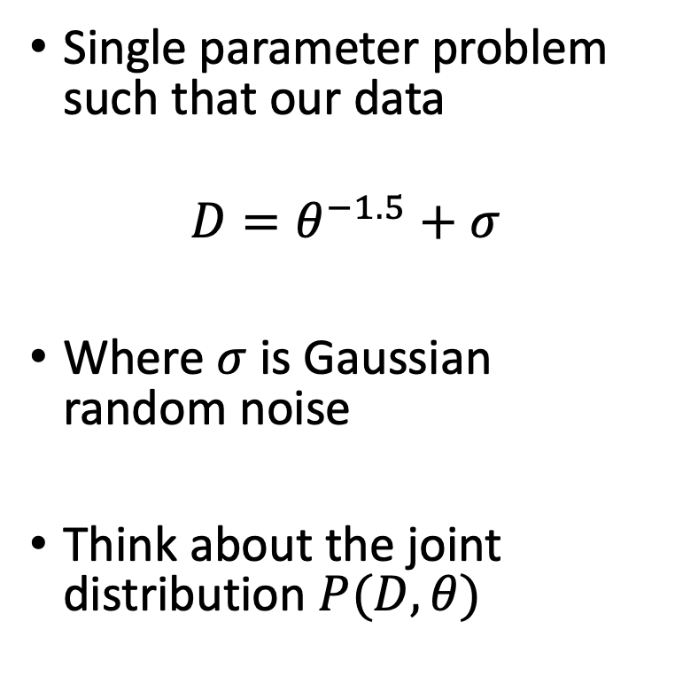
An Example
Single parameter problem such that our data
$$D=θ^{−1.5}+σ$$
Where $σ$ is Gaussian random noise
Think about the joint distribution $P(D, θ)$

Slide 14
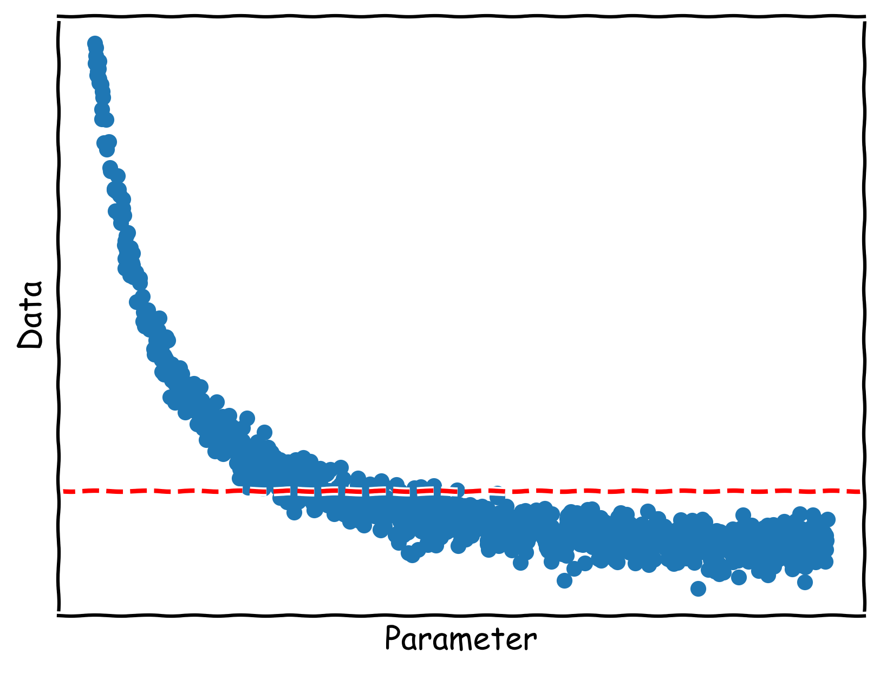
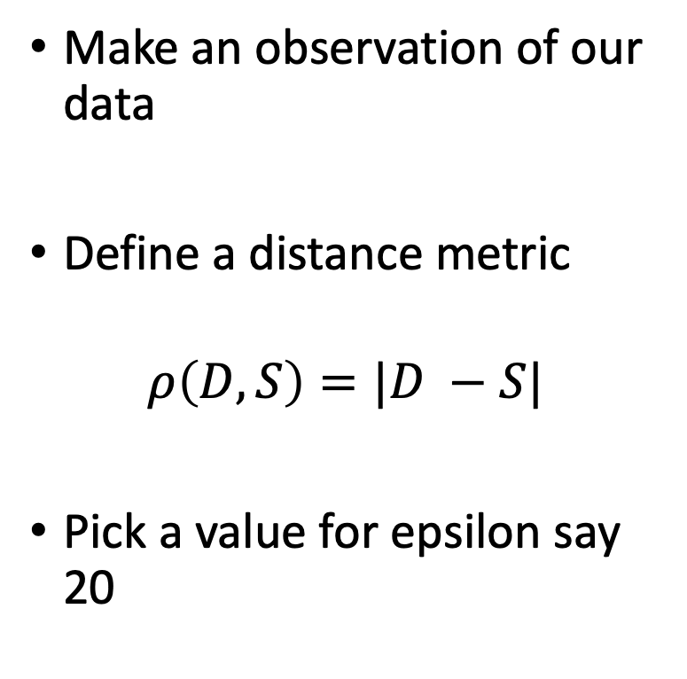
An Example
Make an observation of our data
Define a distance metric
$$ρ\left(D, S\right)=|D −S|$$
Pick a value for epsilon say 20

Slide 15
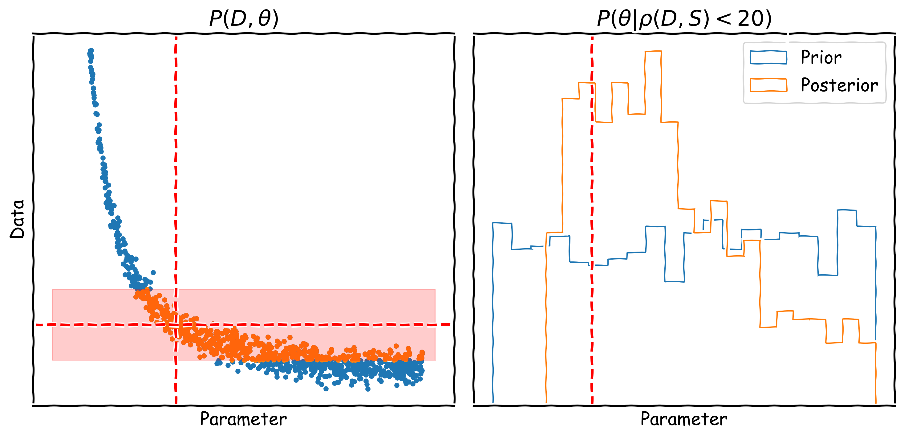
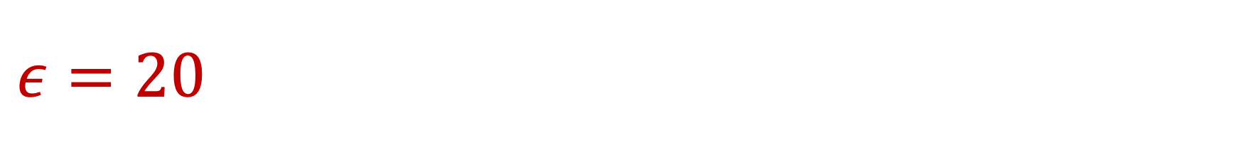
$$ε=20$$

Slide 16
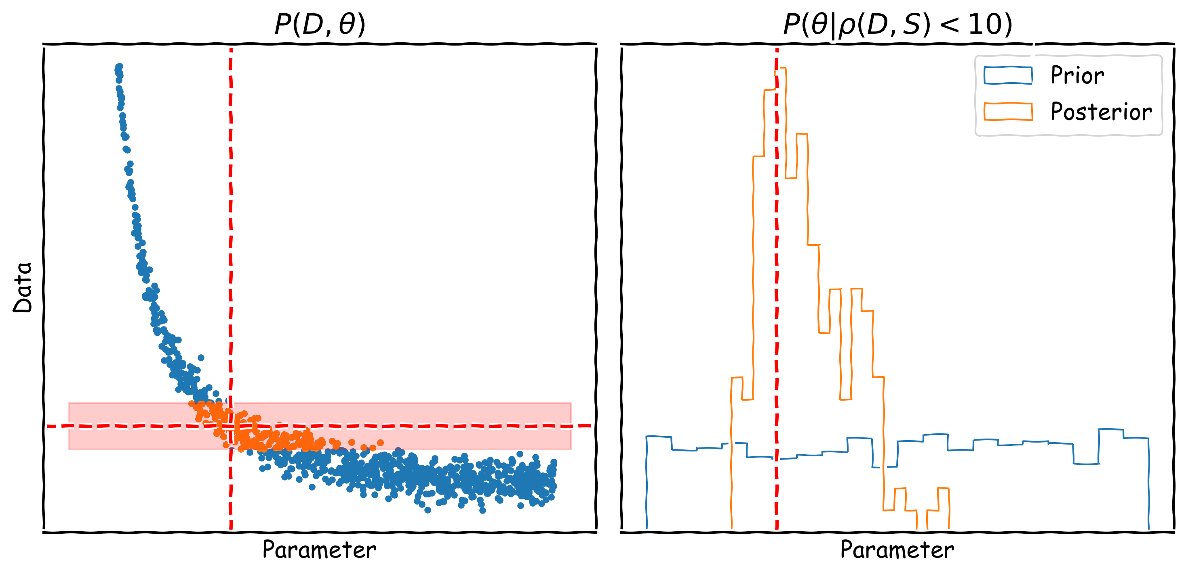
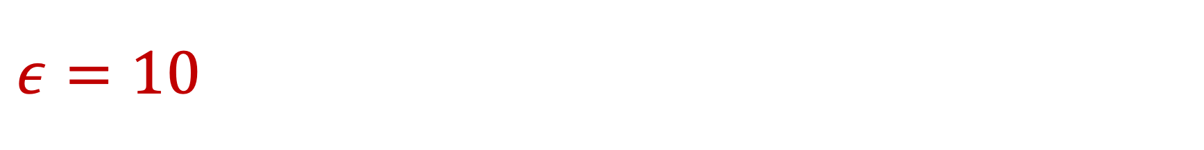
$$ε=10$$

Slide 17
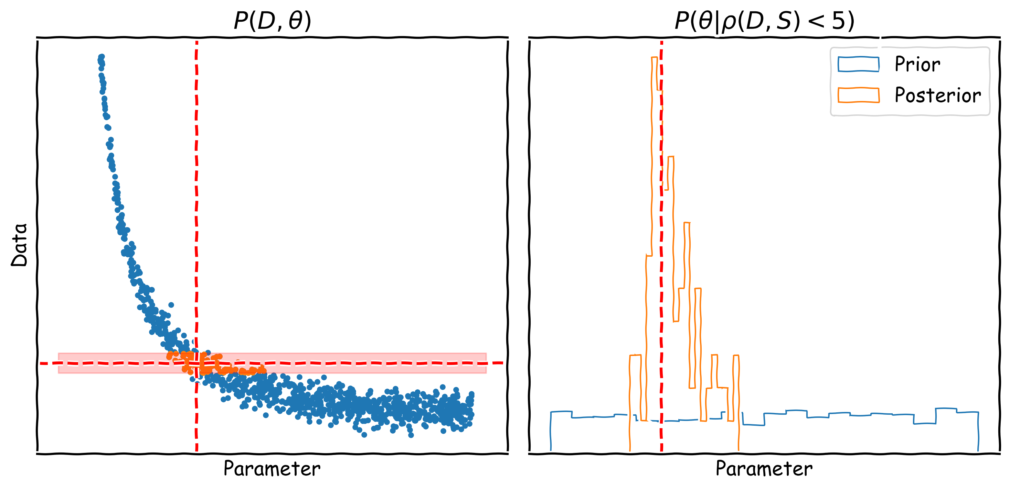
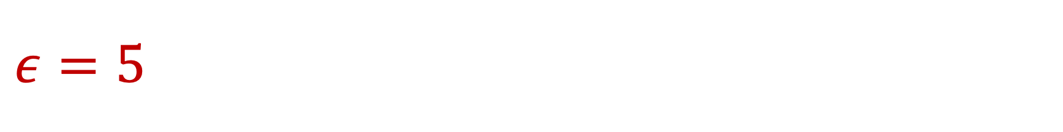
$$ε=5$$

Slide 18
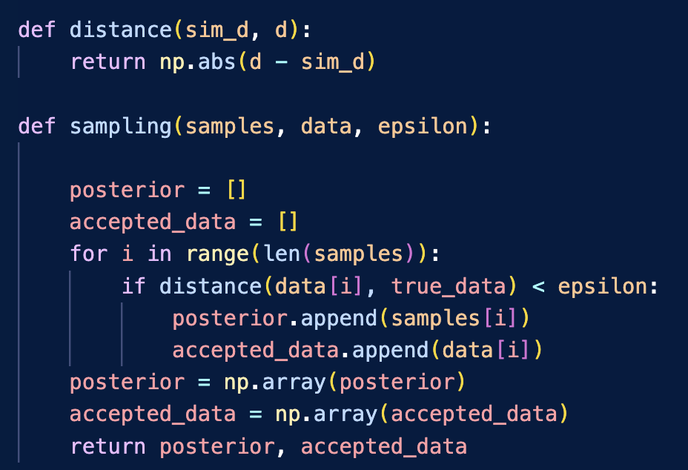
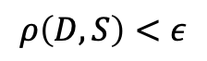
What does the algorithm look like?
Distance Metric
Prior samples and simulations
$$ρ\left(D, S\right)<ε$$
Accepted samples and simulations

Slide 19
No likelihood calls
We did not make a single call to any likelihood function here
But there is a cost to generating our simulations (so it might still be slow)
We could use emulators to generate the simulations if they are prohibitively costly (e.g. the VAE we saw last lecture)
Typically need fewer simulation calls than during an MCMC run
Likelihood might be intractable anyway so MCMC might not be an option

Slide 20
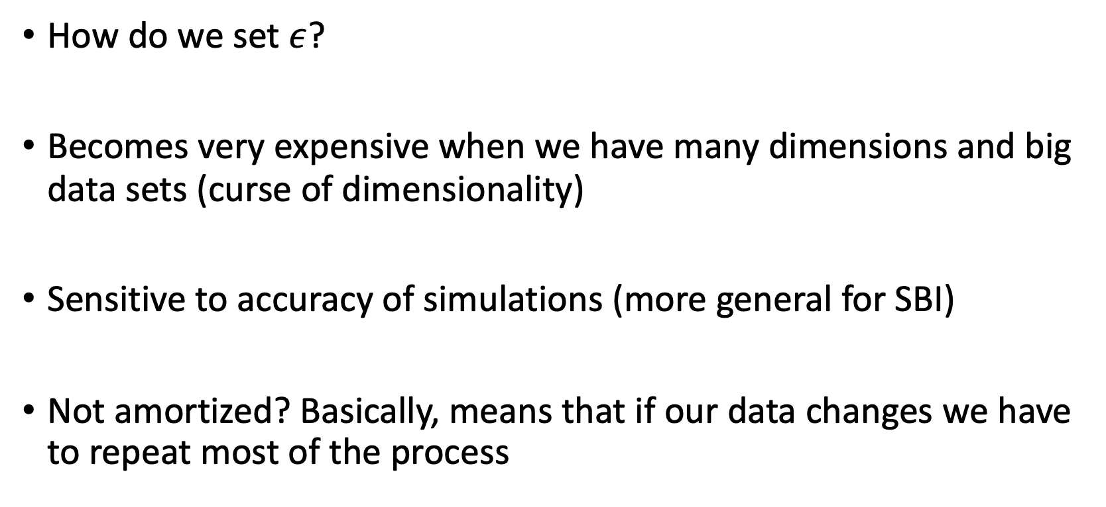
Problems with ABC?
How do we set $ε$?
Becomes very expensive when we have many dimensions and big data sets (curse of dimensionality)
Sensitive to accuracy of simulations (more general for SBI)
Not amortized? Basically, means that if our data changes we have to repeat most of the process

Slide 21
Neural Posterior Estimation (NPE)

Slide 22
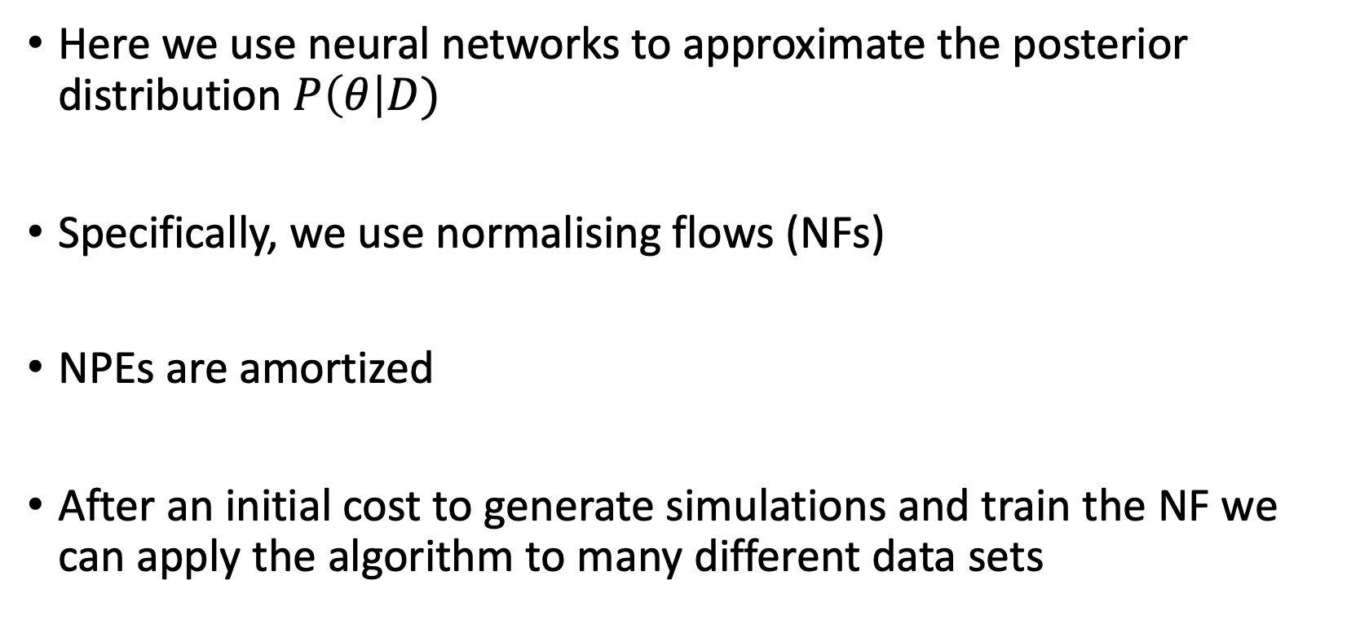
What is NPE?
Here we use neural networks to approximate the posterior distribution $P\left(θ\right|D)$
Specifically, we use normalising flows (NFs)
NPEs are amortized
After an initial cost to generate simulations and train the NF we can apply the algorithm to many different data sets

Slide 23
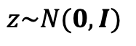
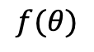
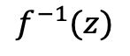
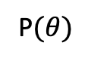
Normalizing Flows (NFs)
Invertible transformation from some known distribution (a multi-variate Gaussian) to a more complex target distribution (a posterior for example)
Focusing on Masked Autoregressive Flows (MAF) which comprises of a series of Masked Autoencoder for Distribution Estimation (MADE, Papamakarios et al 2017) neural networks
P$(θ)$
$$f(θ)$$
$$z\sim N(0, I)$$
$$f^{−1}(z)$$

Slide 24
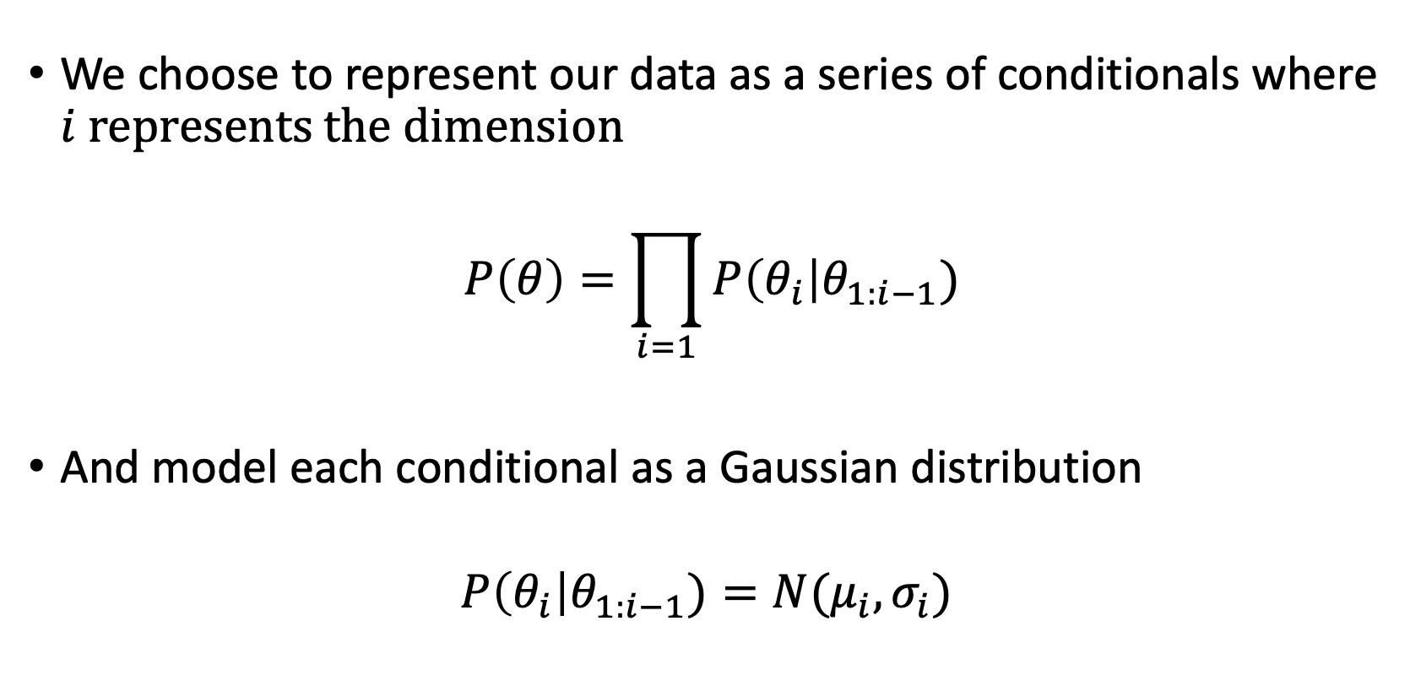
Normalizing Flows (NFs)
We choose to represent our data as a series of conditionals where $i$ represents the dimension
$$P\left(θ\right)=\prod_{i=1}{P\left(θ_{i}\right|θ_{1:i−1})}$$
And model each conditional as a Gaussian distribution
$$P\left(θ_{i}\right|θ_{1:i−1})=N(μ_{i},σ_{i})$$

Slide 25
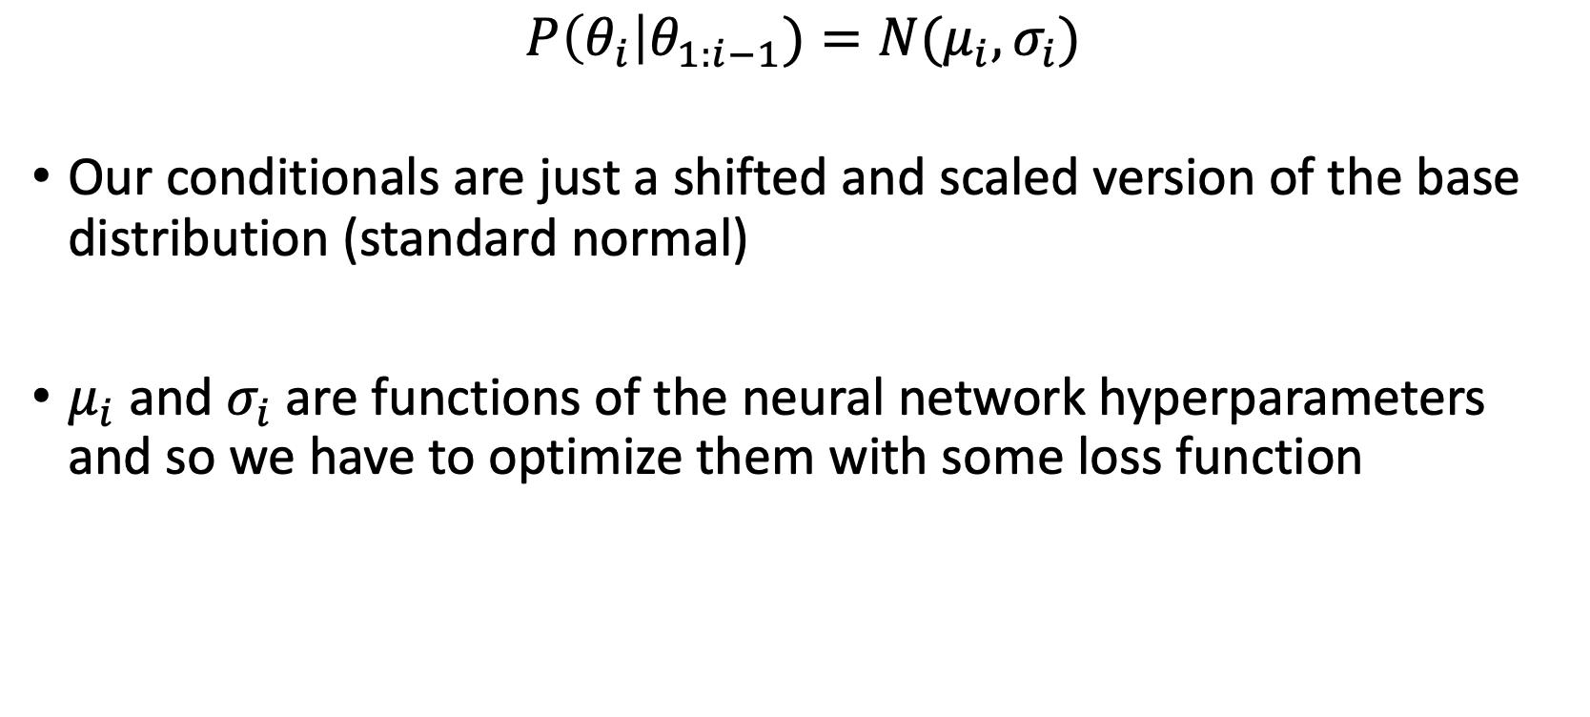
Normalizing Flows (NFs)
$$P\left(θ_{i}\right|θ_{1:i−1})=N(μ_{i},σ_{i})$$
Our conditionals are just a shifted and scaled version of the base distribution (standard normal)
$μ_{i}$ and $σ_{i}$ are functions of the neural network hyperparameters and so we have to optimize them with some loss function

Slide 26
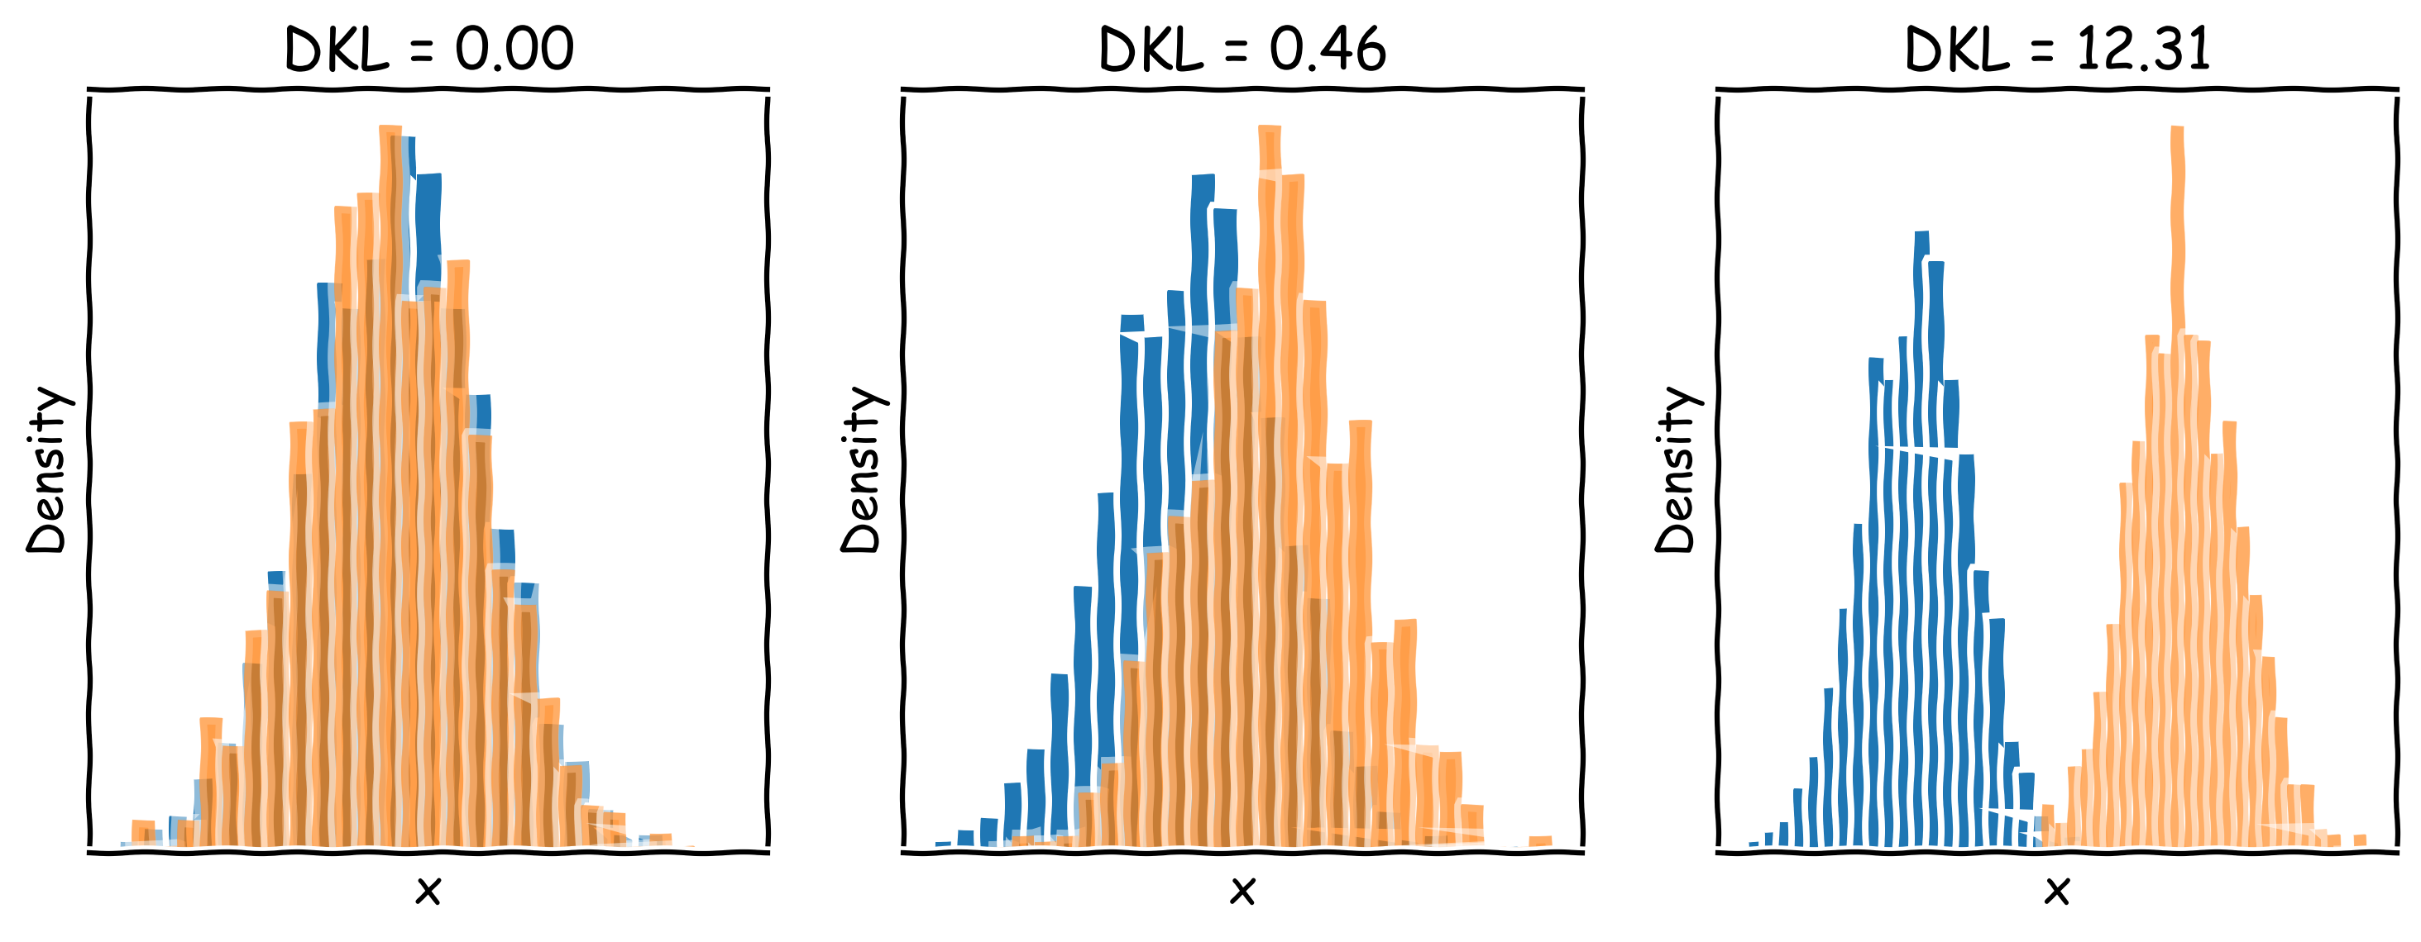
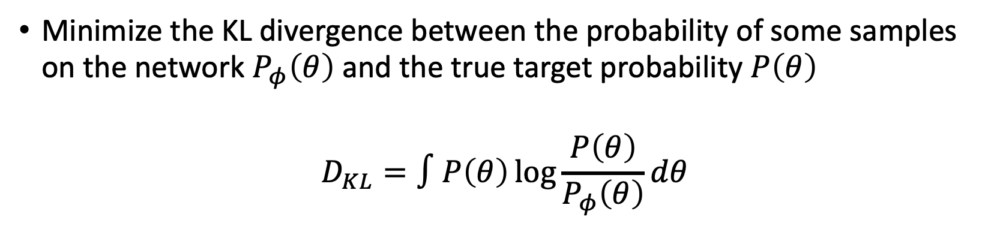
Normalizing Flows (NFs)
Minimize the KL divergence between the probability of some samples on the network $P_{φ}\left(θ\right)$ and the true target probability $P\left(θ\right)$
$$D_{KL}=∫P\left(θ\right)\log{\frac{P\left(θ\right)}{P_{φ}\left(θ\right)}}dθ$$

Slide 27
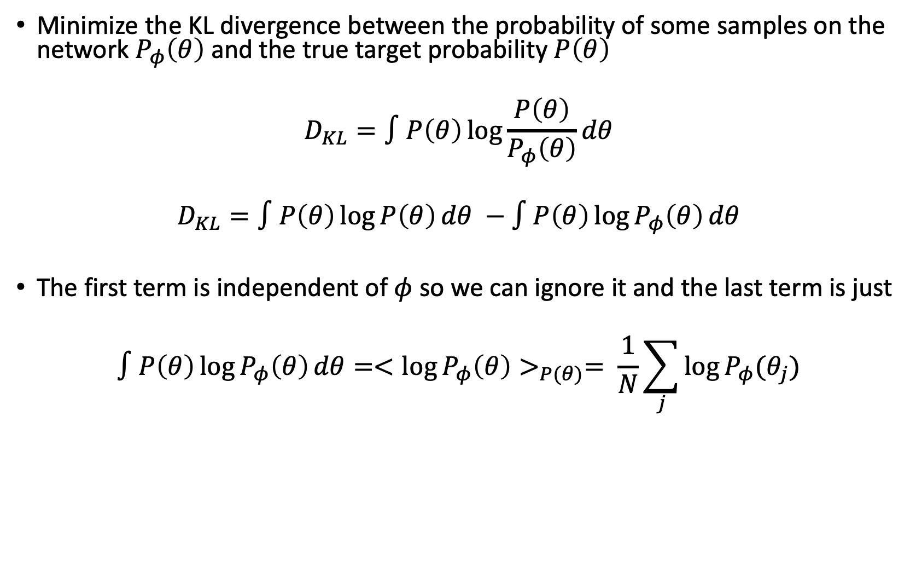
Normalizing Flows (NFs)
Minimize the KL divergence between the probability of some samples on the network $P_{φ}\left(θ\right)$ and the true target probability $P\left(θ\right)$
$$D_{KL}=∫P\left(θ\right)\log{\frac{P\left(θ\right)}{P_{φ}\left(θ\right)}}dθ$$
$$D_{KL}=∫P\left(θ\right)\log{P\left(θ\right)}dθ −∫P\left(θ\right)\log{P_{φ}\left(θ\right)}dθ$$
The first term is independent of $φ$ so we can ignore it and the last term is just
$$∫P\left(θ\right)\log{P_{φ}\left(θ\right)}dθ=<\log{P_{φ}\left(θ\right)>_{P(θ)}= \frac{1}{N}\sum_{j}{\log{P_{φ}(θ_{j})}}}$$

Slide 28
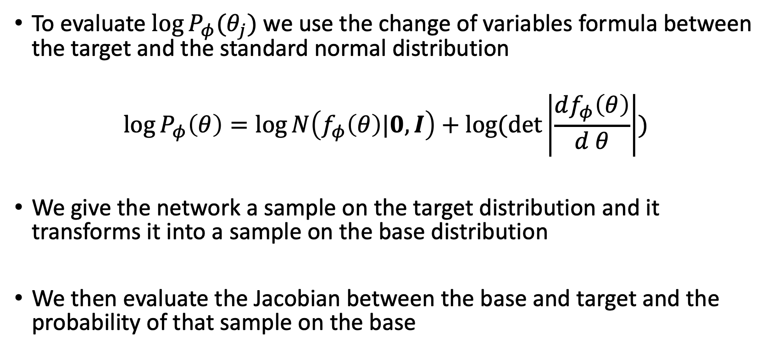
Normalizing Flows (NFs)
To evaluate $\log{P_{φ}(θ_{j})}$ we use the change of variables formula between the target and the standard normal distribution
$$\log{P_{φ}\left(θ\right)=\log{N\left(f_{φ}\left(θ\right)|0,I\right)+\log{(\det\left|\frac{df_{φ}\left(θ\right)}{d θ}\right|)}}}$$
We give the network a sample on the target distribution and it transforms it into a sample on the base distribution
We then evaluate the Jacobian between the base and target and the probability of that sample on the base

Slide 29
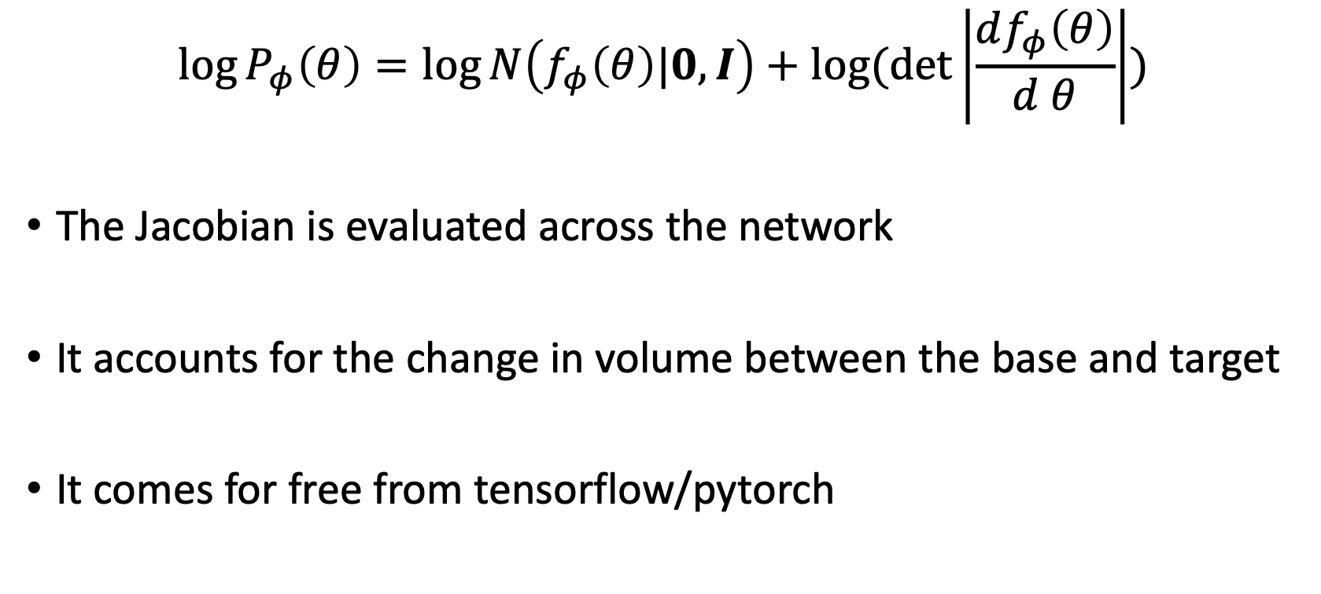
Normalizing Flows (NFs)
$$\log{P_{φ}\left(θ\right)=\log{N\left(f_{φ}\left(θ\right)|0,I\right)+\log{(\det\left|\frac{df_{φ}\left(θ\right)}{d θ}\right|)}}}$$
The Jacobian is evaluated across the network
It accounts for the change in volume between the base and target
It comes for free from tensorflow/pytorch

Slide 30
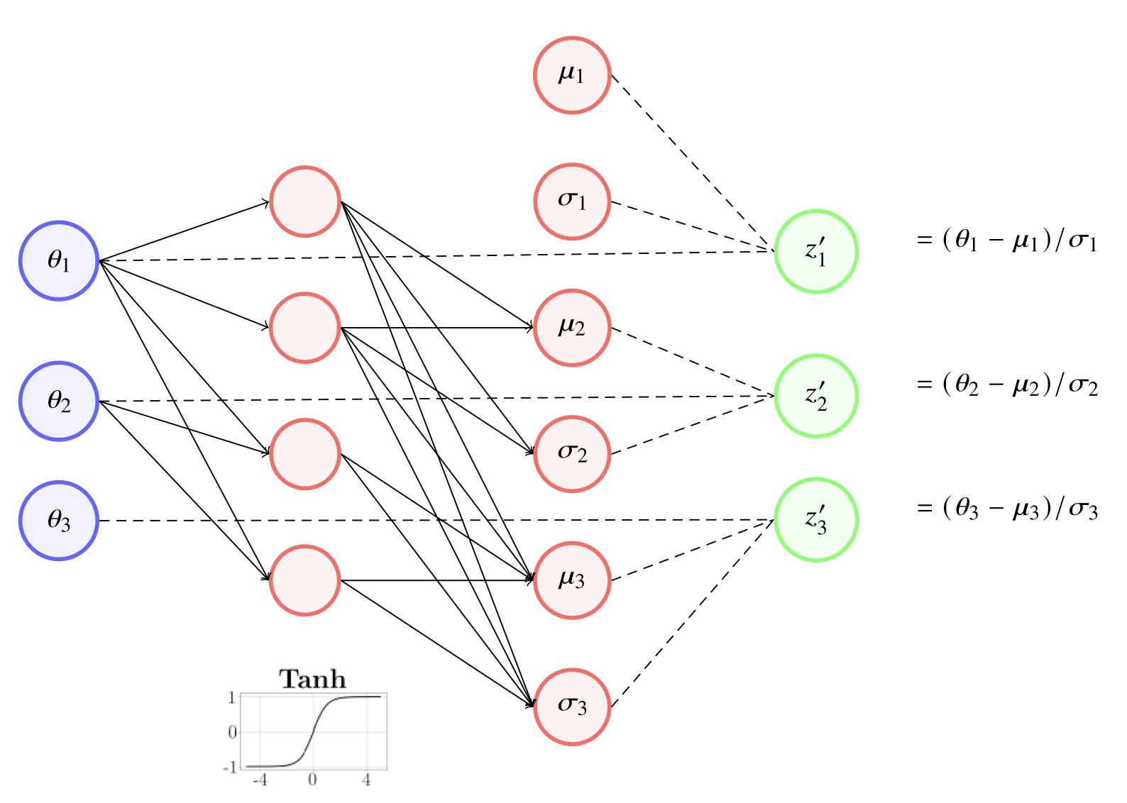
Masked Autoencoder for Distribution Estimation (MADE)
Bevins et al 2023

Slide 31
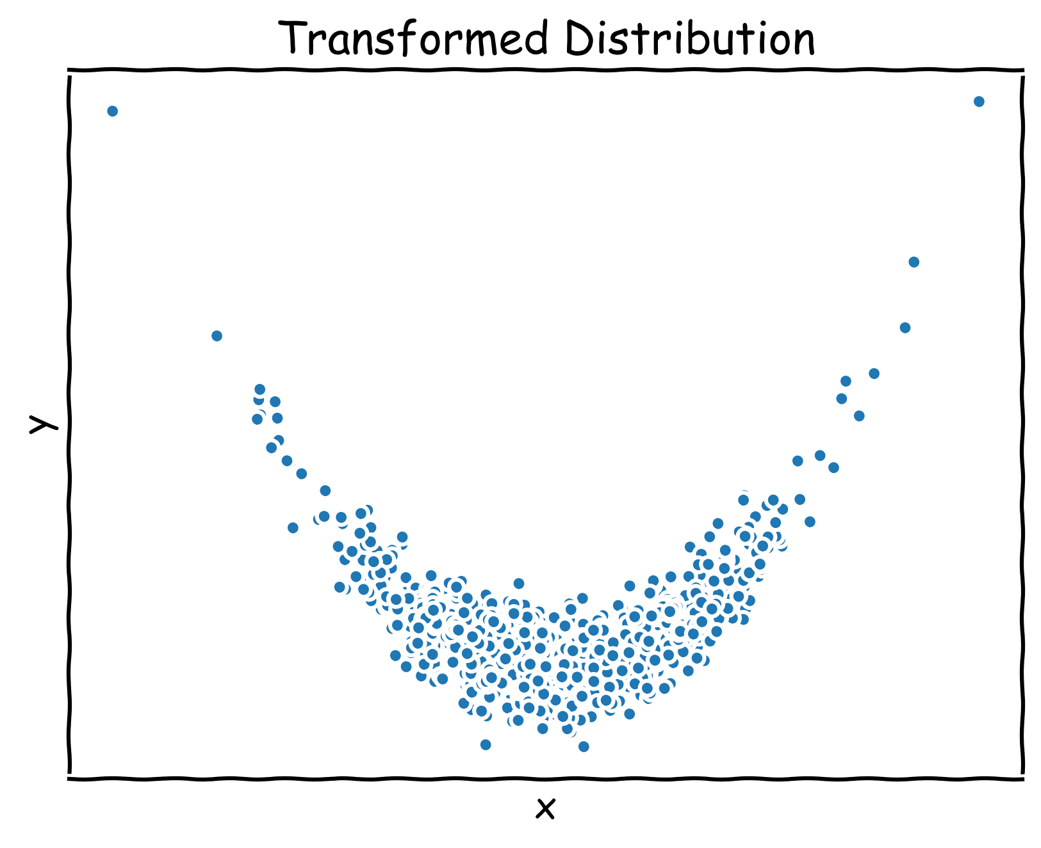
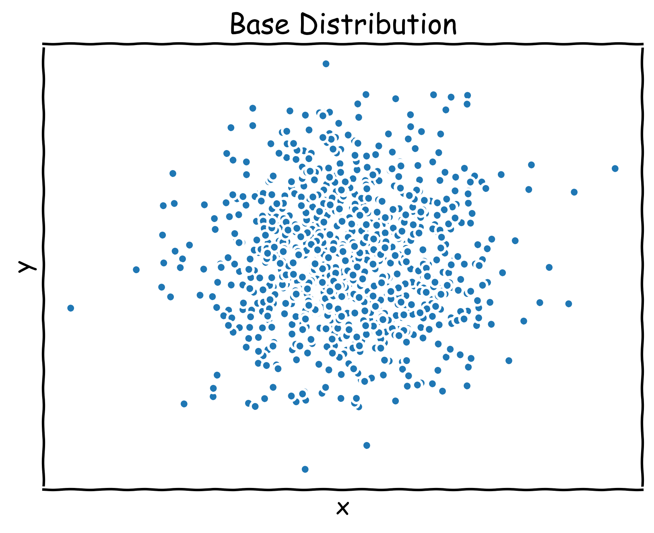
Masked Autoregressive Flow (MAF)
Training
Sampling
Chain a series of MADEs together to get MAFs
Idea is that we can learn more complex distributions with more complex architectures
Essentially shifting and scaling repeatedly the base distribution
The modelled conditionals in each MADE will be slightly different

Slide 32
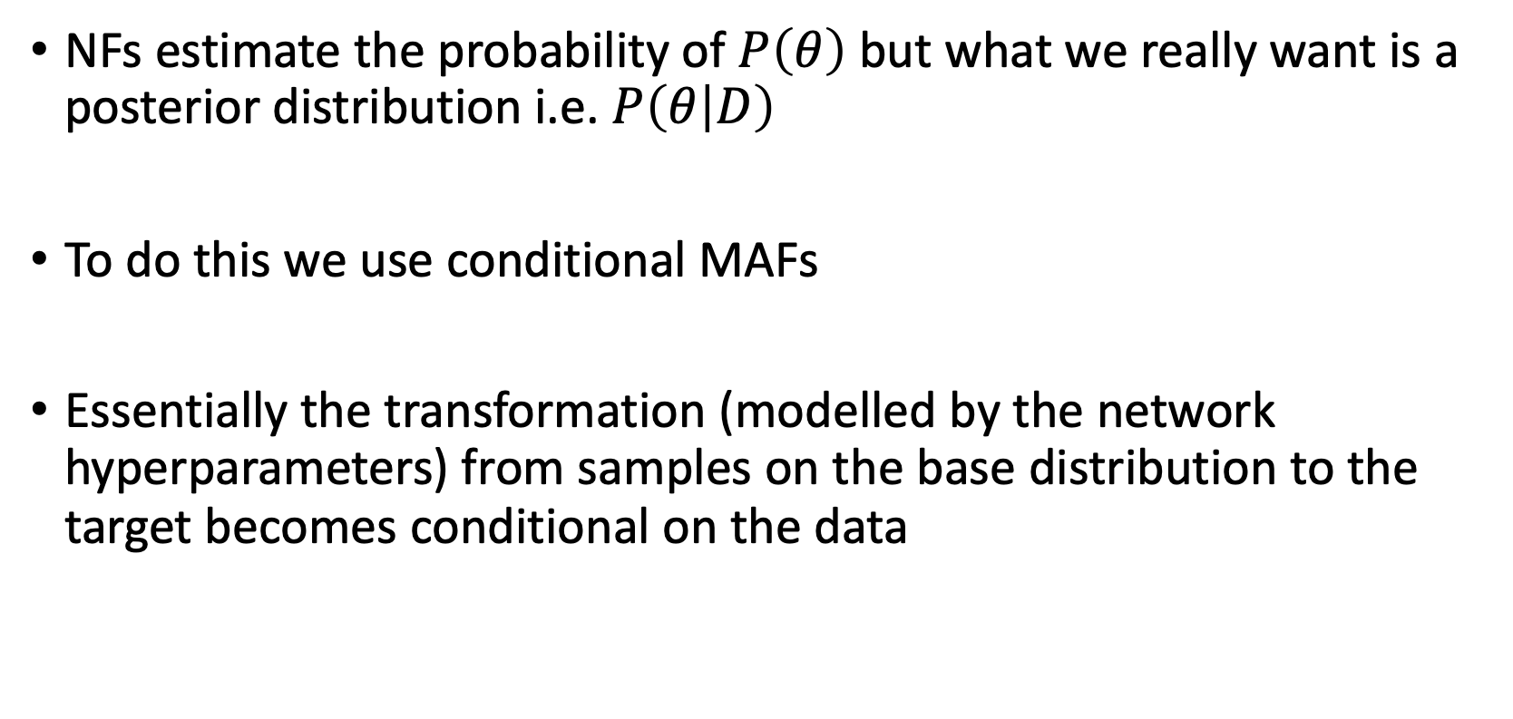
But this is just density estimation?
NFs estimate the probability of $P\left(θ\right)$ but what we really want is a posterior distribution i.e. $P\left(θ | D\right)$
To do this we use conditional MAFs
Essentially the transformation (modelled by the network hyperparameters) from samples on the base distribution to the target becomes conditional on the data

Slide 33
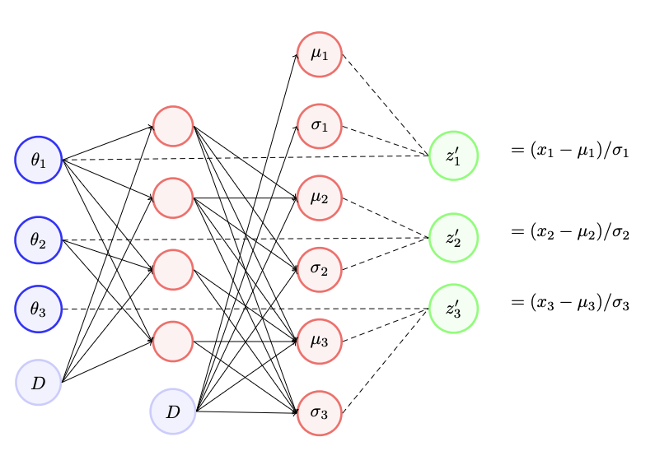
Conditional MADE

Slide 34
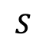
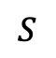
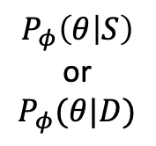
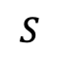
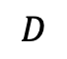
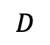
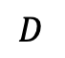
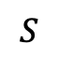
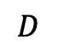
Conditional MAF
Training
$$S$$
$$S$$
$$S$$
$$S$$
$$P_{φ}\left(θ | S\right)$$
or
$$P_{φ}(θ|D)$$
$$D$$
$$D$$
$$D$$
$$D$$
Sampling

Slide 35
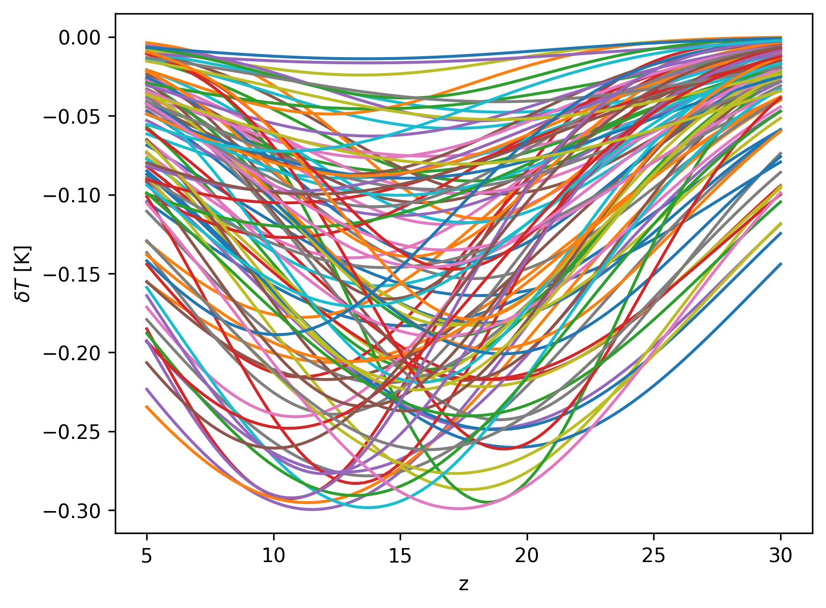
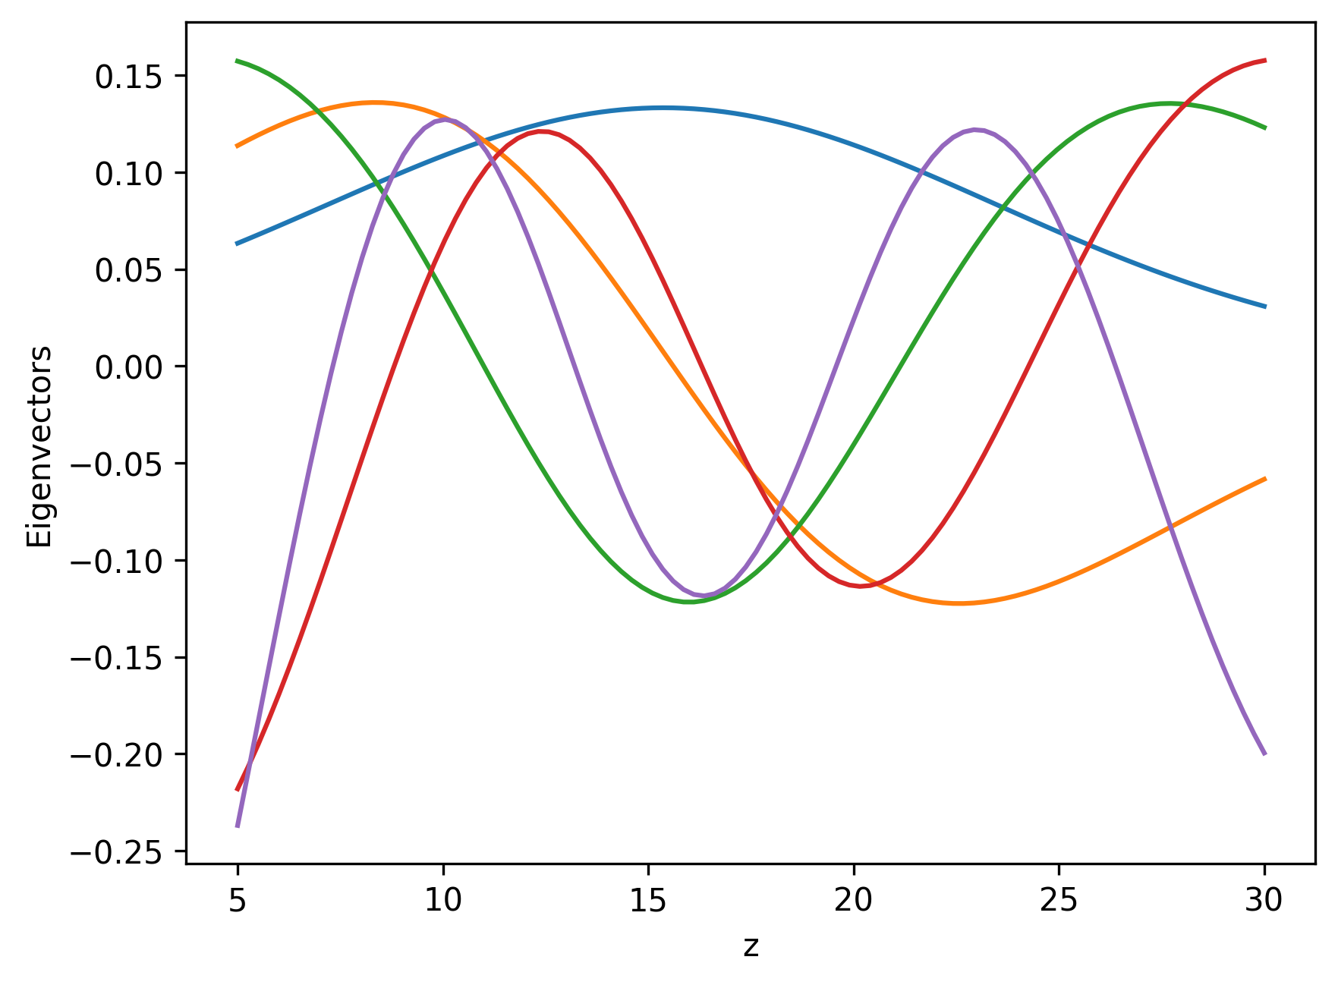
An example: 21cm Cosmology
Think again about sky-averaged 21-cm Cosmology
Transforming a 3D space of Amplitude, central redshift and width
No noise for simplicity
Conditioned on 100D data space!!
Need to do some compression

Slide 36
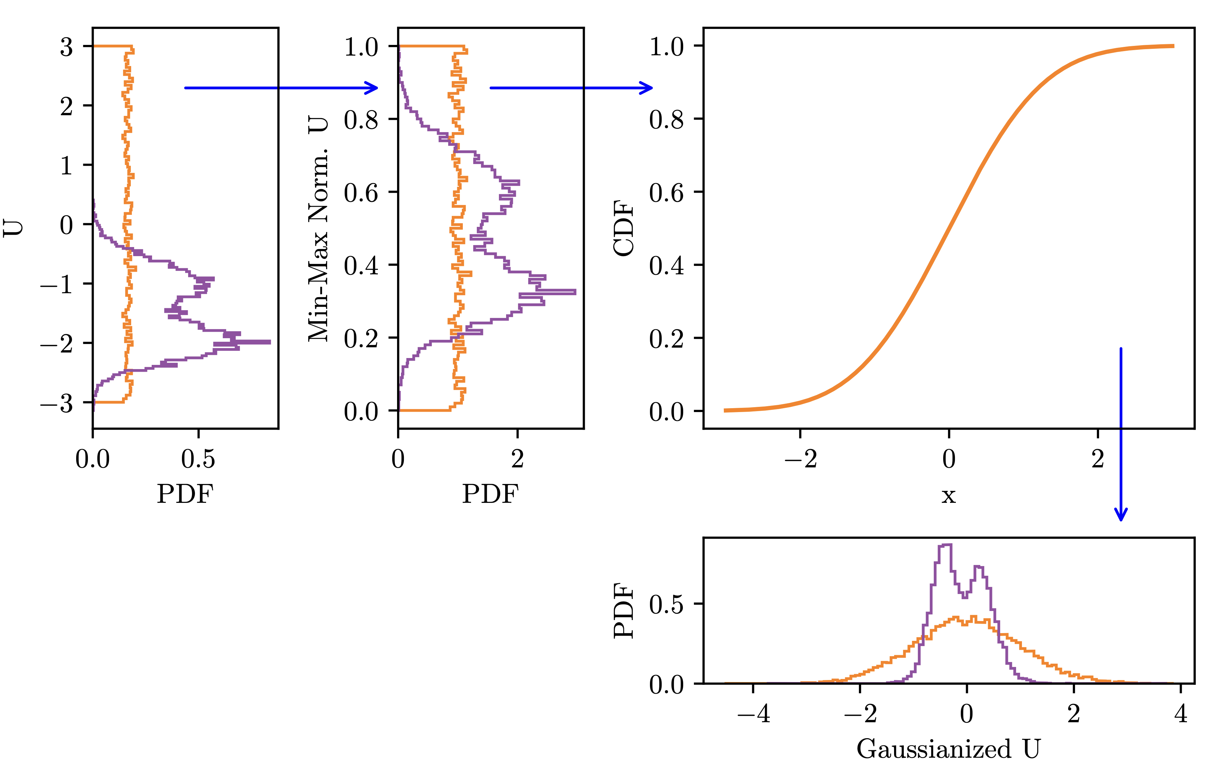
An example: 21cm Cosmology
Example code on https://github.com/htjb/Talks
Quite non-trivial tensorflow set up but hopefully the basic idea is clear
We have to do the usual tricks normalising our parameter and data space
Bevins et al 2023

Slide 37

An example: 21cm Cosmology
We train on pairs of parameters and simulated data
But once trained we pass the network samples from the base distribution and the observed data
Returns a posterior distribution!

Slide 38

An example: 21cm Cosmology
Once trained the NPEs are very fast
They are amortized so we can show them another observation and recover a posterior
But we have to be confident that our observation is well represented by the simulations

Slide 39
Neural Ratio Estimation (NRE)

Slide 40

What is NRE?
NREs are an alternative to ABC and NPE and work by predicting ratios of densities
Typically, we set NREs up to give us the ratio $\frac{P(D|θ)}{P(D)}= \frac{L(θ)}{Z}$
We can sample over our NRE and multiply the ratio with a prior probability to recover a properly normalised posterior

Slide 41

As a classification problem
NREs are essentially classifiers
We train with pairs of data and parameters that go together with a label (probability) of 1 and pairs that do not go together with label 0
Use a binary cross entropy loss function
$$L=\frac{1}{N}\sum_{i}{y_{i}log\left(σ∙f\left({\tilde{D}}_{i}, θ_{i}\right)\right)+\left(1−y_{i}\right)\log\left(1 −σ∙f\left({\tilde{D}}_{i}, θ_{i}\right)\right)}$$
Where $y_{i}=1 (0)$ for matched (mis-matched) data and parameters and $f\left({\tilde{D}}_{i}, θ_{i}\right)$ is the predicted probability that the data goes together or not

Slide 42


As a classification problem
Simulations/Data $\tilde{D}$
Probability that the data
came from the parameters
Parameters $θ$

Slide 43

As a classification problem
We can interpret exponential of $f\left(\tilde{D}, θ\right)$ as
$$r= \frac{P(\tilde{D}, θ)}{P\left(\tilde{D}\right)P(θ)}$$
Which is the ratio of the probability that the simulation and parameters are from the joint distribution or are independent
We can express this in more familiar language as
$$r=\frac{P(\tilde{D}, θ)}{P\left(\tilde{D}\right)P(θ)}= \frac{P(\tilde{D}|θ)P(θ)}{P\left(\tilde{D}\right)P(θ)}= \frac{L\left(θ\right)π(θ)}{Z π(θ)}= \frac{L(θ)}{Z}$$

Slide 44

As a classification problem
The network learns what kind of data different sets of parameters produce
We then feed the network the real data that we have observed and samples of $θ$ from a prior to recover a posterior as
$$P\left(θ | D\right)=r π\left(θ\right)= \frac{L(θ)}{Z} π(θ)$$
Watch out some python packages implement their own sampling algorithms!
NREs are amortized like NPEs

Slide 45


An Example: 21cm Cosmology
Lets do the same example again
Generate a set of example signals with matching parameters $s=\left\{\tilde{D}\left(θ\right), θ\right\}$ and assign them a label of 1
Shuffle the parameters and signals so that we have $s^{′}=\{\tilde{D}\left(θ\right), φ\}$ with label 0
No data compression here (although it is often needed)

Slide 46



An Example: 21cm Cosmology
Train the NRE
Sample a prior and evaluate $P(θ|D)$ using the NRE
Here I am just sampling uniformly across the prior
But really want to wrap this inside an NS or MCMC implementation

Slide 47
Summary

Slide 48
Simulation Based Inference
A growing field of interest
Advantageous when we cannot analytically write a likelihood function
But strongly dependent on the accuracy of our simulations
We are still learning about how SBI methods scale to higher dimensions and cope with model misspecification

Slide 49




Join the research group!
Will Handley’s
Group
You’ve heard a lot from a lot of people during this course!
We are always interested in prospective PhD students
The group works on a diverse range of topics so hopefully we are doing something that interests you!
Related opportunities in Will Handley’s Group (Cavendish/Kavli) and Anastasia Fialkov’s Group (IoA/Kavli)
Remember there are code examples at https://github.com/htjb/Talks/tree/master/Lectures/MPhil_Data_Intensive_Science_Lectures
Eloy’s Group
Anastasia Fialkov
Group

